Slide 1

How do Organisms
Reproduce?
Sexual Reproduction in flowering plants ( Structure of a flower )

Slide 2


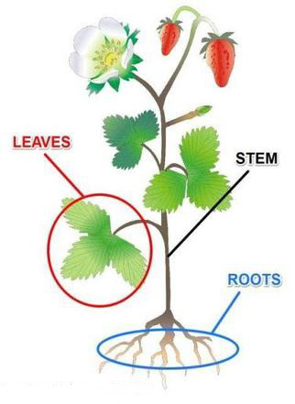
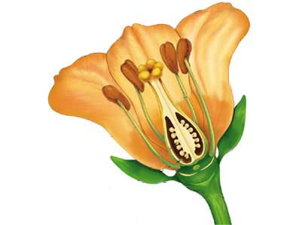
Plants
Vegetative organs
Reproductive organs

Slide 3
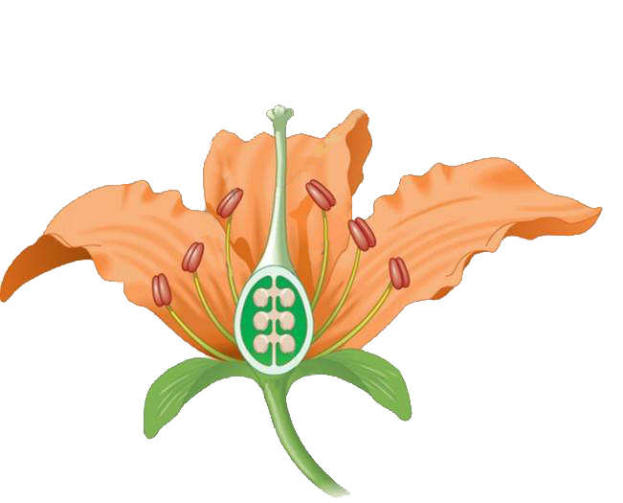


Sexual Reproduction in flowering plants
The terminal part which may be sticky
Stigma
Middle elongated part
CARPEL
Anther
Style
STAMEN
Petals
The swollen bottom part
Filament
Ovary
Female reproductive part
It produces pollen grains that are yellowish in colour.
Petals are colourful and larger in size and they protect the inner parts of the flower and also attract insects.
Male reproductive part
Sepals
Carpel is present in the centre of a flower and is the female reproductive part. It is made of three parts.
Sepals and Petals are called the outer protective parts of the flower
Sepals protect the flower in bud condition and also perform the function of photosynthesis
Stamen is the male reproductive part

Slide 4
Thank You

